Slide 1


Establishing Effective Ethics Program Practices
Michael J. Elston: Chief Ethics & Compliance Officer, United States Postal Service
Marcella Goodridge: Deputy Assistant General Counsel & ADAEO, Department of Education
Kristina Spencer: Attorney, Department of Education

Slide 2
“Stealth” Ethics Training
Michael J. Elston
Associate General Counsel and Chief Ethics & Compliance Officer
U.S. Postal Service

Slide 3
Goals
Promote a culture of compliance with policies, business objectives, regulations, and criminal laws.
Reinforce law-abiding, reasonable, and prudent behavior while discouraging illegal, unethical, and wasteful behavior.
Contribute to revenue generation or cost savings.

Slide 4
Opportunities
Less than 2,000 of our over 500,000 employees receive annual ethics training.
USPS has experienced significant financial shortfalls since 2011, making money for new programs scarce.
USPS is charged with running more like a business and has a culture that is more like a large company than a government agency.
Ethics training viewed as “boring.”

Slide 5
What are Smart Business Moments?
Short reminders or “lessons,”
Covering compliance issues from laws to business goals,
Originating from all parts of the Postal Service,
Delivered in multiple formats to ensure wide dissemination, and
Required in certain settings.

Slide 6
How do we generate them?
Postmaster General chartered a Coordinating Committee with representatives from all eight major departments.
Members submitted ideas – quality varied.
About half were edited by a professional writer under contract to corporate communications.
Ultimately, each final YSBM was reviewed and approved by vote of the coordinating committee.

Slide 7
When do we use them?
The Postmaster General’s October 7, 2015 Memorandum established expectations
Any meeting > one hour with ten or more employees involving a formal presentation
Staff meetings (once a month)
Executive Leadership Team Meetings, COO Bi-Weekly Conference Calls, USPS Executive Roundtables
Live USPS training programs

Slide 8
How do you find them?
https://liteblue.usps.gov/smartbusinessmoments/

Slide 9
Better Safe Than Bitten

Slide 10
Better Safe Than Bitten
All carriers are required to keep dog repellent clipped to their satchels or clothing. You can never be sure when it will be needed. A satchel and dog repellent can be used to defend against attacks by dogs or other animals.
Supervisors must caution carriers: Use extra care in making deliveries when dogs and other animals are loose on a route. Never pet or feed a dog. Reassure a dog in a friendly manner — from a distance.

Slide 11
Better Safe Than Bitten
Keeping dog repellent at their ready helps carriers stay safe on their routes, reduces injuries from dog bites, and saves money for the Postal Service.
And that’s smart business.
Refer to Handbook EL-801 for more information.

Slide 12
Fundraising at Work

Slide 13
Fundraising at Work
The Combined Federal Campaign (CFC) is the only authorized solicitation of Postal Service employees on behalf of charitable organizations in the workplace.
All other types of fundraising for charities at work are prohibited. For example, you cannot sell your daughter’s cookies at work or ask your colleagues to purchase items from you to benefit your place of worship.

Slide 14
Fundraising at Work
Fundraising at work can make coworkers feel coerced to contribute, affect morale, and distract us from the work at hand.
Limiting fundraising to the CFC is the law – and it’s SMART BUSINESS.
Contact the Ethics Office (ethics.help@usps.gov) for more information about fundraising.

Slide 15
Marcella Goodridge Keiller, ADAEO/Deputy Assistant General Counsel
Kristina Spencer, Ethics/General Attorney
U.S. Department of Education

Slide 16
Financial Disclosure Report Review at the U.S. Department of Education
Ethics staff at the U.S Department of Education brainstormed on how to improve the financial disclosure review process. This resulted in the development of 2 new protocols:
  Public financial disclosure review form (2 versions: new entrant filers vs incumbent filers)
  Triage system for confidential and public financial disclosure forms

Slide 17
Review Form for Public Financial Disclosure Report
What is the review form?
  A review tool
  A due diligence check list
  A baseline standard of review that can be used to aid and facilitate the review of subsequent reports
  A transitional tool across form reviewers

Slide 18
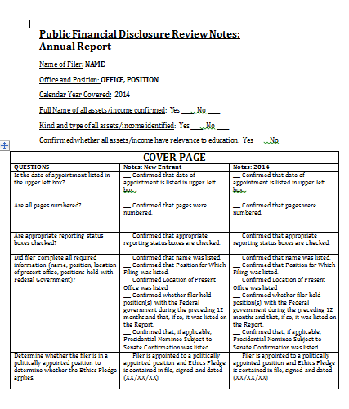
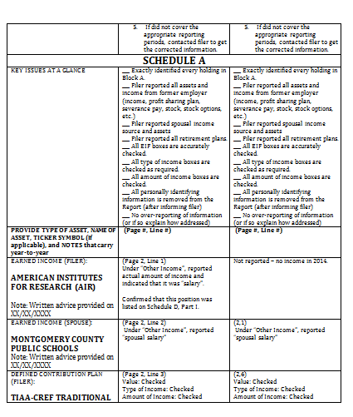
Review Form for Public Financial Disclosure Report (cont’d)
What does the review form look like?

Slide 19
Review Form for Public Financial Disclosure Report (cont’d)
Is the review form helpful?
  Yes! The review form reduced the instances of filers forgetting to provide reportable information
  Yes! The review form ensured reviewers conducted a comprehensive technical review
  Yes! The review form made it easier for reviewers to identify and quickly resolve any conflicts of interest that arose during the review
  Yes! The review form reduced the review and certification time of the reports, both for new entrant, and in particular, incumbent filers

Slide 20
Review Form for Public Financial Disclosure Report (cont’d)
How has Integrity.gov changed the use of the review form?
  The Department uses Integrity.gov for 278 reports
  A modified version of the form is used for new entrant reports filed in Integrity.gov to (1) continue the standard baseline level of review of each report per filer and (2) continue to serve as a due diligence check list for reviewers

Slide 21
Triage Systems for Financial Disclosure Reports
Where did the idea of triage come from?
  With a small staff of less than 15 people, it is difficult to keep up with the volume of reports that come in with each filing season (approx. 1200 450 filers and 300 278 filers)
  Mechanism to ensure that review and certification of reports would occur in a timely fashion (quick turnaround for “low hanging fruit”)
  Prevents any one reviewer from being overwhelmed by a large number of reports

Slide 22
Triage Systems for Financial Disclosure Reports (cont’d)
What is the triage process?
  Separate triage sessions for 450 reports vs 278 reports
  Each week reviewers sit together in one room and review reports that have come in during the prior week
  The reports are preliminarily reviewed (“triaged”) for technical issues and conflict of interest issues – issues are flagged
  After triage, the reports are assigned to a reviewer for a comprehensive review and certification
  The assigned reviewer has the benefit of any notes made from the triage session for issues that require immediate attention, like an actual or apparent conflict of interest
  Reviewers have the opportunity to ask questions about items on a report, which often leads to group discussions about the conflicts analysis for various assets and financial holdings

Slide 23
Triage Systems for Financial Disclosure Reports (cont’d)
What is the triage process for 278 reports filed in Integrity.gov?
  Reports filed in Integrity are assigned to reviewers as they are received
  Reviewers may either triage their assigned 278 reports by (1) bringing their laptops to the triage session to review reports online or (2) independently reviewing their reports by a specific time on the day of triage

Slide 24
Triage Systems for Financial Disclosure Reports (cont’d)
Is the triage process helpful?
  Yes! All reports are preliminary reviewed within 7 business days of being received by our office
  Yes! Reviewers have the opportunity to discuss review issues and participate in large scale discussions about various topics, such as disqualification language
  Yes! Allows for an even distribution of reports amongst a small staff
  Yes! Decreases the likelihood of a backlog of reports for review

Slide 25
Conclusions
Both processes have resulted in a better financial disclosure system and conflict of interest analysis at the Department.
QUESTIONS???

Slide 26


